Slide 1
BIRCH Algorithm

Slide 2
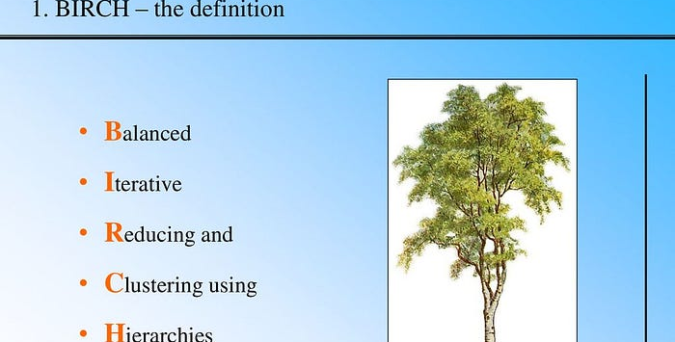

Slide 3
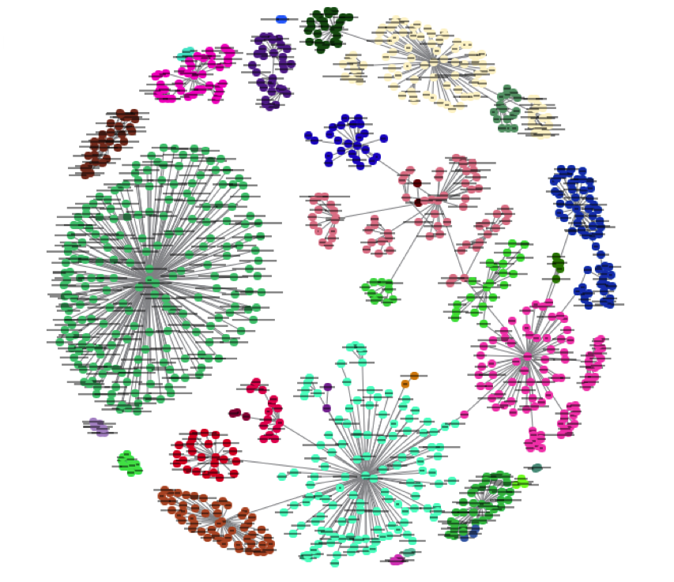
Hierarchical clustering method that incrementally clusters data using a tree structure (CF Tree).

Slide 4
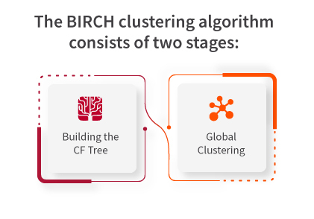

Slide 5
WORK FLOW
Builds a tree of clusters, adding data points to the closest cluster and occasionally splitting or merging clusters.

Slide 6
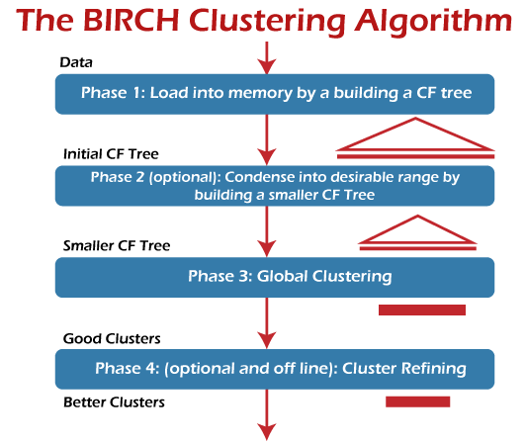
CF Tree
It organizes data hierarchically, storing cluster summaries (CFs) in its nodes. This allows for efficient and scalable clustering, especially in cases where the data is too large to be handled all at once.

Slide 7
Strengths Weaknesses
Scales well to large datasets.
Sensitive to the initial threshold value used to merge clusters.

Slide 8
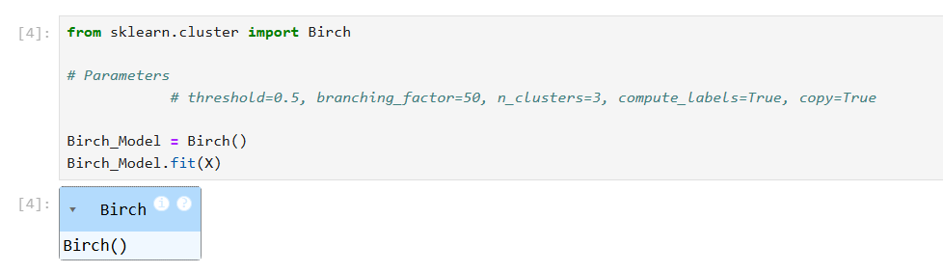
MODEL CREATION

Slide 9
Priyadharsini Manikandan

